Slide 1
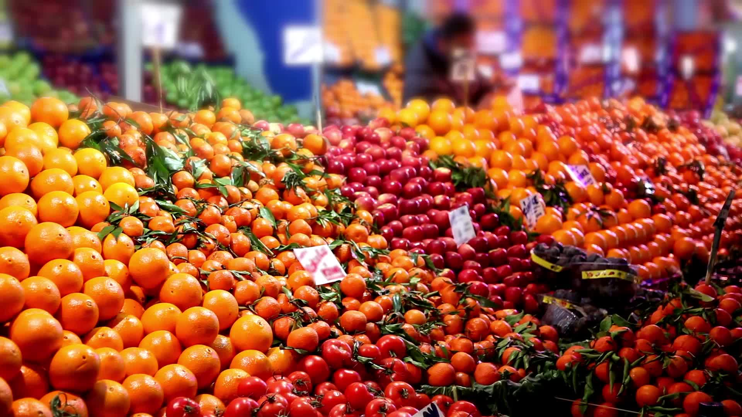
WINMART SUPERMARKET , MYANMAR…..
Supermarket chain in Myanmar, across three cities: Yangon, Naypyitaw and Mandalay.
PRESENTED BY : STEPHANIE ONYENWEZI

Slide 2
INTRODUCTION
WINMART SUPER MARKET IS LOCATED IN MYANMAR, AND HAS BRANCHES ACROSS THREE CITIES: YANGON, NAYPYITAW AND MANDALAY. THIS SLIDES CAPTURES TRANSACTION RECORDS AND PROVIDES A COMPREHENSIVE VIEW OF SALES ACTIVITIES, CUSTOMER DEMOGRAPHICS AND PAYMENT METHOD FROM JANUARY TO MARCH 2019.

Slide 3
PRODUCT LINES
THE PRODUCT LINES IN WINMART SUPER MARKET CHAIN INCLUDES:
HEALTH AND BEAUTY
HOME AND LIFESTYLE
FASHION ACCESSORIES
ELECTRONIC ACCESSORIES
SPORTS AND TRAVEL
FOOD AND BEVERAGES

Slide 4
PROBLEM STATEMENT
What are the underlying factors contributing to the observed decline in sales during specific hours and the decrease in sales volume in certain months?
Why is there a significant sales difference between top-performing categories (Food and Beverages, Sports and Travel) and the underperforming Health and Beauty category, and what strategies can be implemented to drive growth and improve sales performance?
What are root causes contributing to the inconsistent growth patterns across the three branches, and how can strategies be optimized to drive uniform growth and maximize productivity?

Slide 5
FINDINGS AND ANALYSIS
Sales varies widely by hour of the day. Peak performance occurs at 7 pm ($39,698) and 1 pm ($34,719). However, 8pm ($22,967), 5 pm ($24,445), and 4 pm($25,226) show weaker sales. This suggests missed revenue opportunities during off-peak hours.

Slide 6
FINDINGS AND ANALYSIS
Sales peaked in January at $116,296, but dipped in February to $97,214, rebounding in March to $109,465, indicating seasonal fluctuations.

Slide 7
FINDINGS AND ANALYSIS
The supermarket chain has seen varying sales performance across categories, with Food And Beverages leading at $56,154, followed closely by Sports And Travel at $55,126, and Electronic Accessories at $54,338. However, Health And Beauty lags behind at $49,190, indicating potential opportunities for growth.

Slide 8
FINDINGS AND ANALYSIS
The supermarket branch in Naypyitaw leads regional sales at $110,572, surpassing Mandalay's $106,200 and Yangon's $106,203, indicating strong market potential in the capital city. Sales are evenly distributed between Mandalay and Yangon, suggesting opportunities for targeted growth initiatives

Slide 9
FINDINGS AND ANALYSIS
BONUS FINDINGS
The supermarket's initiative to encourage customer membership registration has led to increased loyalty and repeat patronage. Which has a significant impact and increase in revenue from sales.

Slide 10
RECOMMENDATION
OFFER EARLY BIRD DEALS FOR THE EARLY HOURS SHOPPERS TO INCREASE MORNING PATRONAGE AND OPTIMIZE STAFFING.
CONDUCT AN ANALYSIS TO IDENTIFY THE KEY FACTORS CONTRIBUTING TO LOW SALES AND DEVELOP TARGETED STRATEGIES TO ADDRESS THESES CHALLENGES AND STABILIZE SALES PERFORMANCE.
FOCUS ON HIGH MARGIN GOODS ( FOOD & BEVERAGES) AND CROSS SELL ITEMS ON PRODUCT LINES. EXAMPLE , CROSS SELL ITEMS ON PRODUCTLINE HEALTH AND BEAUTY WITH SPORTS AND TRAVEL.
REPLICATE TOP BRANCH’S MODEL AND LAY OUT FOR MORE PRODUCTIVITY.
USE DATA DRIVEN CAMPAIGNS AND DIGITAL EXPANSION TECHNIQUES TO ATTRACT MORE SALES TO THE SUPERMARKET.
BONUS RECOMMENDATION- PRIRIOTIZE CONTINIOUS PROMOTION OF DIGITAL LOYALTY INCENTIVES.

Slide 11
CONCLUSION
The supermarket demonstrates strong overall performance with steady sales and loyal customer activity. However, growth has begun leveling off, signaling the need for renewed strategies.
By optimizing sales hours, cross selling product lines, enhancing customer experience, and replicating high-performing branch models, the supermarket can achieve sustained growth, stronger profitability, and a more competitive market position.

Slide 12
THANK YOU!

